Slide 1
ANALYTICS FOR
CUSTOMER LIFETIME VALUE
IN E-COMMERCE
CAPSTONE PROJECT
Tam Nguyen & Uyen Tran
Stetson-Hatcher School of Business

Slide 2
Table of Contents
01
02
03
04
05
INTRODUCTION
OBJECTIVE
ANALYTICAL APPROACH
RESULTS
RECOMMENDATION

Slide 3
WHAT IS CUSTOMER LIFETIME VALUE?
Customer Lifetime Value (CLV) is the total revenue a business can reasonably expect from an existing customer throughout the business relationship
CLV
Customer Value
x
Average Customer Lifespan
=
Customer Value = Average Purchase Value * Average Frequency Rate
Average Purchase Value = Total Revenue over a time frame / Total number of purchase over the same time frame
Average Frequency Rate = Total number of purchases over a period / Total number of customers during the same period
Average Customer Lifespan = Average number of days customers stay active / Total number of customers
Introduction
Objective
Analytical Approach
Results
Recommendations
Notes:
Calculate historical data to understand the customer behavior

Slide 4
Objective
Enhance the efficiency of marketing spend by focusing on high-value customers
Improve customer retention through personalized marketing strategies
Tasks:
Profiling customers based on behaviors, demographic information, and preference
Determine best method to classify customer segment for E-commerce
Introduction
Objective
Analytical Approach
Results
Recommendations

Slide 5
Analytical Approach
Step 1
Step 3
Step 5
DATA PROCESSING
CLUSTER ANALYSIS
PARAMETRIC & NON-PARAMETRIC
Step 2
Step 4
Step 6
CALCULATING CLV
RFM MODEL
PROFILING
RECOMMENDATION
Introduction
Objective
Analytical Approach
Results
Recommendations

Slide 6
Our Data
Online Sales data: actual orders data (point of sales data) at transaction level
Customer data: customers’ demographic information
Discount Coupon data: Discount coupons have been given for different categories in different months
Marketing Spend data: Marketing spend on both offline & online channels on day wise
Tax Details data: GST Details for given category
Source: Kaggle
Business context: non-contractual e-commerce company
MARS
Introduction
Objective
Analytical Approach
Results
Recommendations

Slide 7
Our Data
Attributes | Description
Number of Day | __Number of days the customer stay active
Number of Transactions | __Total number of transaction of each customer within the observed period
Total Purchase Amount | __Total revenue acquired from each customer
Quantity | __Total quantity purchased by each customer
Gender | __Gender of the customer
Location | __Location of the customer
Tenure (months) | __Length of time that a customer has been actively engaging with a business or service, measured in month
AOV | __Average purchase value of each customer
Churn Rate | __The percentage rate at which customers stop buying product
Profit Margin | __The amount of profit expected from each customer over the average customer lifespan
Before Aggregation
19 variables,
52,924 observations
After Aggregation
10 variables,
1,468 observations

Slide 8
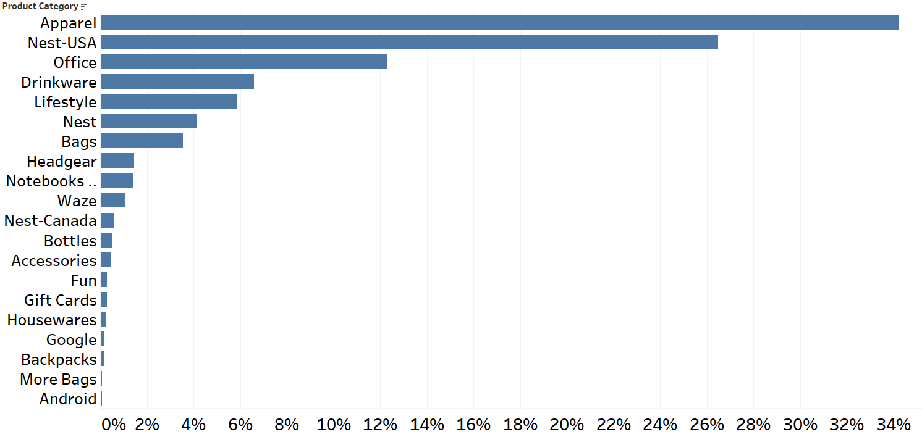
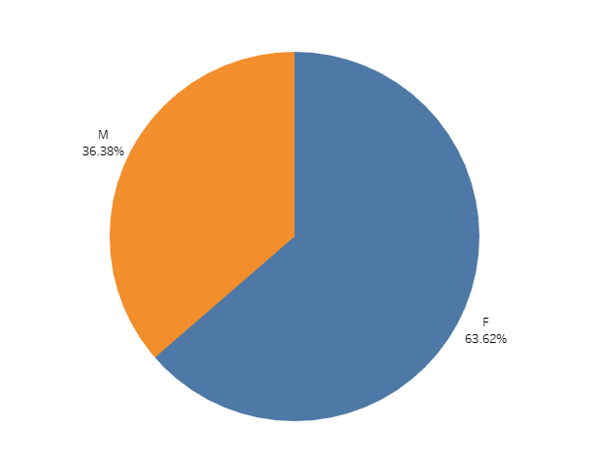
Exploratory Data Analysis
Distribution Transaction by Product Category
Distribution Transaction by Gender
Apparel & Net-USA represent frequently purchased products.
Female customers appear to make up the majority of transactions.
Introduction
Objective
Analytical Approach
Results
Recommendations

Slide 9
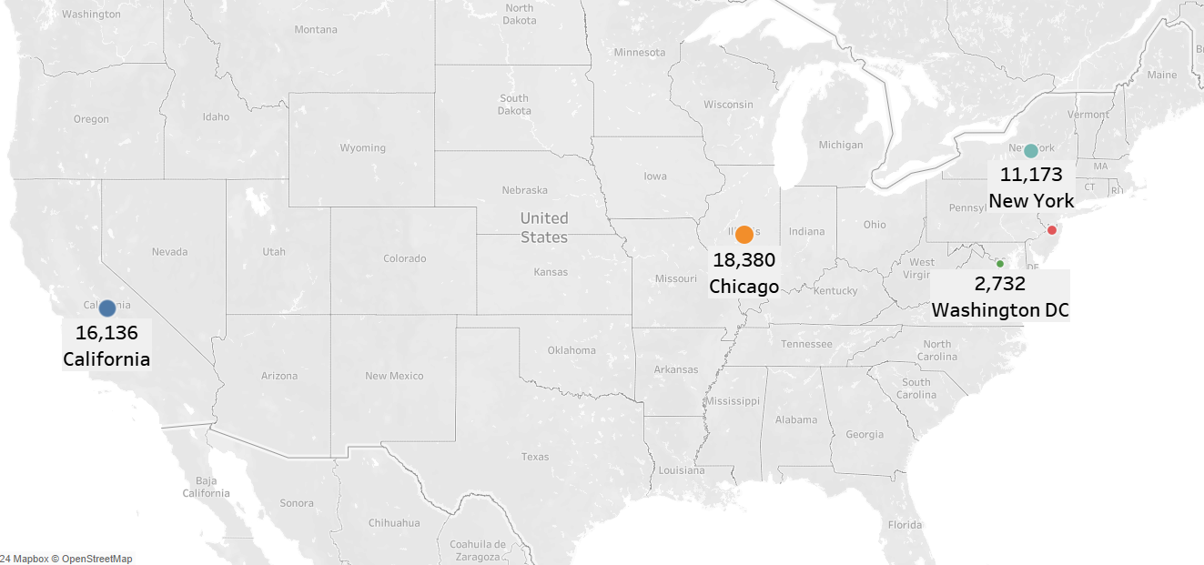
Exploratory Data Analysis
Transaction by Location
10,000
New Jersey
Introduction
Objective
Analytical Approach
Results
Recommendations

Slide 10
Cluster Analysis
Variables
K-Means
To partition a dataset into clusters such that each data point belongs to the cluster with the nearest mean
Recency
Frequency
Monetary
CLV
Introduction
Objective
Analytical Approach
Results
Recommendations
Notes:
Upon processing the data, we moved on to segmenting customers into groups with similar characteristics. So we do this by implementing the K-Means clustering, with four variables: R, F, M and CLV after normalization.

Slide 11
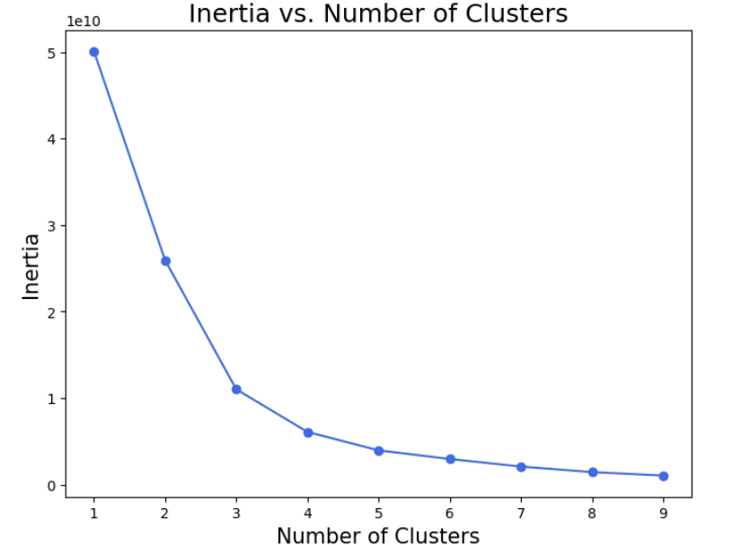
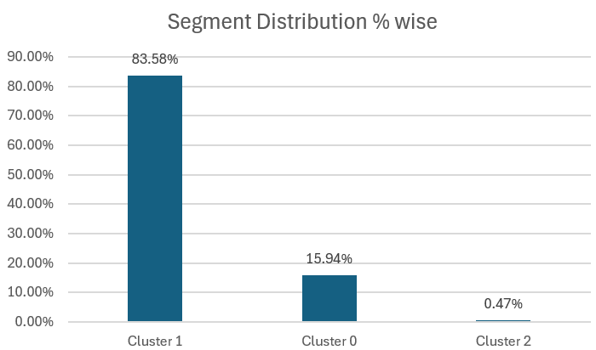
Cluster Analysis
Cluster No | Cluster Name | Quantity | Tenure (months) | AOV | Recency | Frequency | Monetary | CLV | Location | Gender
2 | Premium | 2806 | 30 | 125 | Most Recent | Most Frequent | High | High | Chicago | Female
0 | Gold | 476 | 26 | 123 | Semi-Recent | Semi-Frequent | Average | Average | California | Female
1 | Silver | 87 | 25 | 97 | Least Recent | Least Frequent | Low | Low | California | Female
Introduction
Objective
Analytical Approach
Results
Recommendations
Notes:
Then, we find the optimal number of clusters using the elbow method, which suggests 3 clusters for optimal segmentation, as you can see on the left graph. On the Top Right, we have our segment distribution percentage-wise. Cluster 2, which is our “Premium” segment, only accounts for 0.47%, as compared to “Gold” and “Silver” segments, which account for a relatively larger proportion of. The metrics of each cluster are demonstrated in the table. Cluster attributes are found by profiling process, which is done by adding other variables such as Location, Gender, Quantity, Tenure, and AOV to the existing cluster data frame.

Slide 12
Profiling Result
Q: Which customers will generate the highest profits for e-commerce companies?
Silver
Gold
Premium
Lowest customer relationship length & AOV
Least recency & Frequency
Low Monetary & CLV
Location: California
Gender: Female
Average customer relationship length
Average Recency & Frequency
High AOV
Average Monetary & CLV
Location: California
Gender: Female
Longest customer relationship length
Highest Frequency & Recency
Highest Monetary, AOV & CLV
Location: Chicago
Gender: Female
Introduction
Objective
Analytical Approach
Results
Recommendations
Notes:
The resulting 3 clusters are named Premium, Gold, and Silver with the corresponding characteristics:
The premium customers are those who interact most frequently with the company, have the highest spending and shopping frequency. These customers are mostly located in Chicago.
Similarly, “Gold” segment include those people who don’t shop frequently, but once they do, they make valuable purchase that enhance the revenue stream of the company.
Silver is the lowest-value segment who shop least frequently and bring the lowest monetary value to the company.
Interestingly, the majority of shoppers in all 3 segments are female, which is understandable since the company’s main product is apparel.

Slide 13
Model
Balance data in training set:
Customer_Segment
0 1232
1 235
2 7
dtype: int64
Customer_Segment
0 1202
1 1202
2 1232
dtype: int64
SMOTE - Tomek
Before balance
After balance
SMOTE: generating synthetic examples from the minority class
Tomek: removing the majority class examples that are near the decision boundary
Introduction
Objective
Analytical Approach
Results
Recommendations
Notes:
Our Next step is building a classification model that the company can use to predict which segment their existing customer belong to for appropriate marketing strategy.
Due to the imbalance in the cluster proportion, which can affect the model result, we have implemented the balancing technique SMOTE-Tomek,

Slide 14
Technique Selection
Q: What is the best technique to classify CLV segment for E-commerce?
Model: P(Customer Segment | Quantity, Gender, Location, Tenure, AOV)
 | Multinomial Logistic Regression | Classification Tree | Random Forest | XGBoost
Accuracy | 0.89 | 0.92 | 0.95 | 0.94
Introduction
Objective
Analytical Approach
Results
Recommendations
Notes:
Then, the customer classification model is built based on information such as purchase quantity, gender, location, tenure and AOV. In this, Random Forest shows superior performance as compared to other method, with 95% accuracy overall.

Slide 15
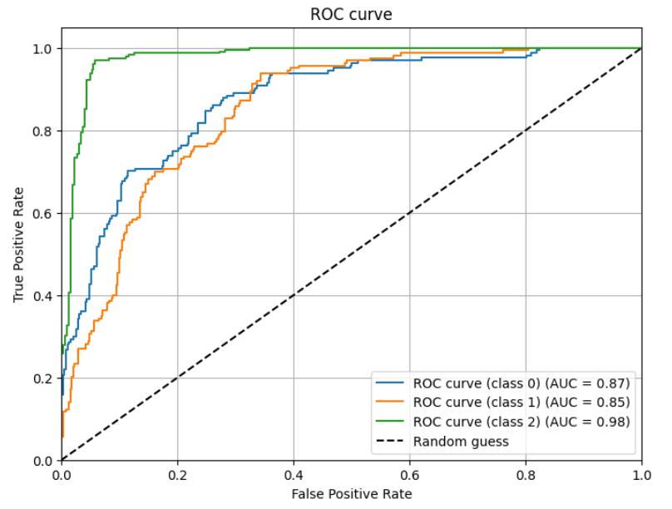
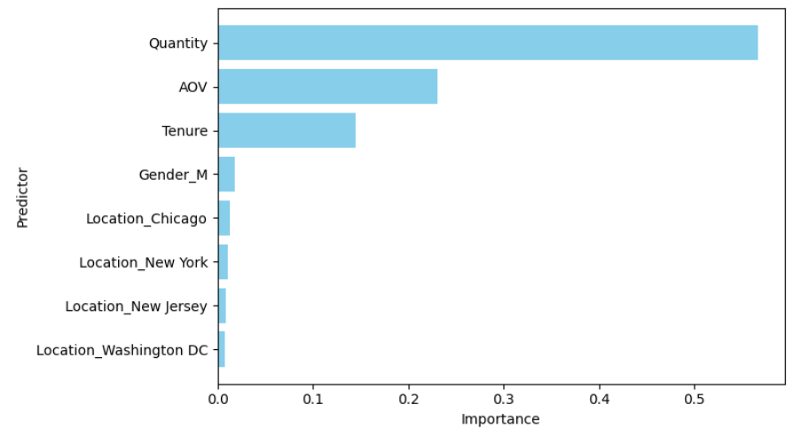
Technique Evaluation
ROC Curve
The importance of variables for the model
Class 0: Silver
Class 1: Gold
Class 2: Premium
Introduction
Objective
Analytical Approach
Results
Recommendations

Slide 16
Market Basket Analysis
P(Apparel) if you use the rule
Antecedents | Consequents | Support | Confidence | Lift
Drinkware | Apparel | 0.045010 | 0.446910 | 1.377784
Apparel | Drinkware | 0.045010 | 0.138762 | 1.377784
Lifestyle | Apparel | 0.033079 | 0.484229 | 1.492836
Apparel | Lifestyle | 0.033079 | 0.101981 | 1.492836
Office | Apparel | 0.062128 | 0.441577 | 1.361343
Apparel | Office | 0.062128 | 0.191536 | 1.361343
Office | Drinkware | 0.046287 | 0.328985 | 3.266516
Drinkware | Office | 0.046287 | 0.459588 | 3.266516
Office | Lifestyle | 0.035114 | 0.249575 | 3.653381
Lifestyle | Office | 0.035114 | 0.514019 | 3.653381
Your chances of getting Apparel are 1.38 times better if you use the rule than if you select randomly

Slide 17
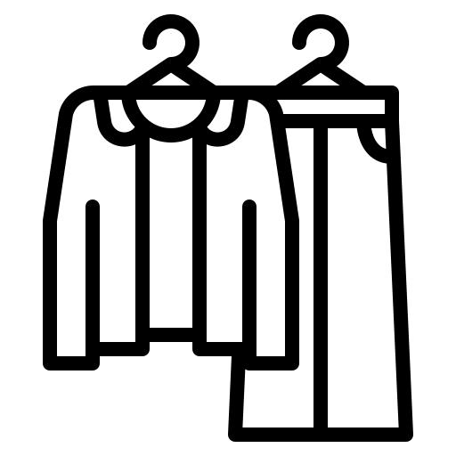



Integrate Customer ID with Combination Preference
Combo | The customers who may buy these combo
Drinkware + Apparel | ID 12356| Female | Chicago | Silver Member
Lifestyle + Apparel | ID 12347 | Male | New York |Gold Member
Office + Apparel | ID 12348 | Male | California | Silver Member
Personalized marketing strategy
Implement Segment-Specific Campaigns to target customers based on their segment preferences
Introduction
Objective
Analytical Approach
Results
Recommendations
Notes:
To translate these findings into valuable insights for the business, we integrate unique customer ID with their corresponding combination preference. For example, a combination of Drinkware and Apparel is popular among females from Chicago who are Silver Members. Customer with ID 12356 is one of those. From this, we can tailor our marketing strategy more effectively for certain groups of customers.

Slide 18
Recommendations
Personalized Advertisement: Send targeted email campaigns to customers based on their preferences. Additionally, create compelling ad content featuring relevant product combinations and guide users to optimized landing pages.
Dynamic Website Content Enhancement: Tailor the content displayed to customers on the company website to emphasize combinations that resonate with the preferences of their respective segments
Price Strategies: Premium pricing for high-CLV customers or low pricing for low-CLV
Retention Strategies: Offering limited-time deals, bundle offers, or discounts for Silver and exclusive benefits, and personalized experiences for Premium group
Basket Product Development: Recommend combo products that align with their preferences
Introduction
Objective
Analytical Approach
Results
Recommendations
Notes:
Following that, we propose the following key recommendations:
First thing is the implementation of personalized advertisement + adjustment of the content displayed on the business website to align with the observed preferences => This personalization will enhance user experience & encourage longer site visits and increased purchasing.
Third, premium pricing strategies for High-Value customers to maximize revenue, and Lower-Pricing for low-Value customers can help increase their buying frequency and potentially convert them into higher-value segments.
For customer retention, introduce limited-time deals for SILVER , and exclusive benefits for PREMIUM to reinforce their value to our brand.
Last but not least, develop new product bundles that align with popular combinations identified previously. This will cater directly to proven customer preferences, encouraging repeat purchases and higher order values.

Slide 19
Thank You

Slide 20
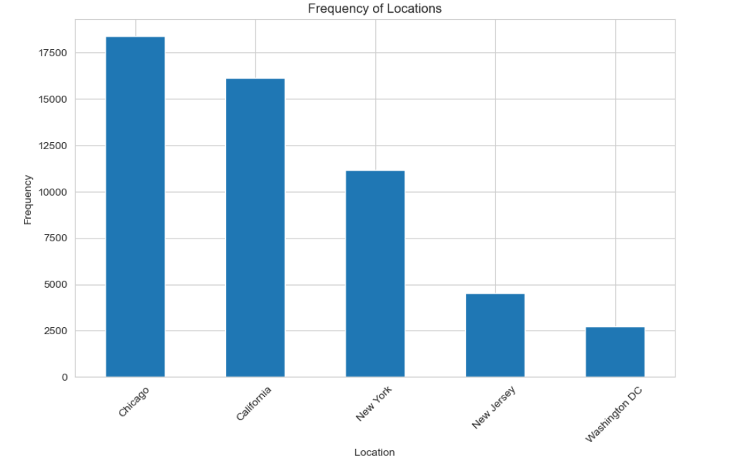
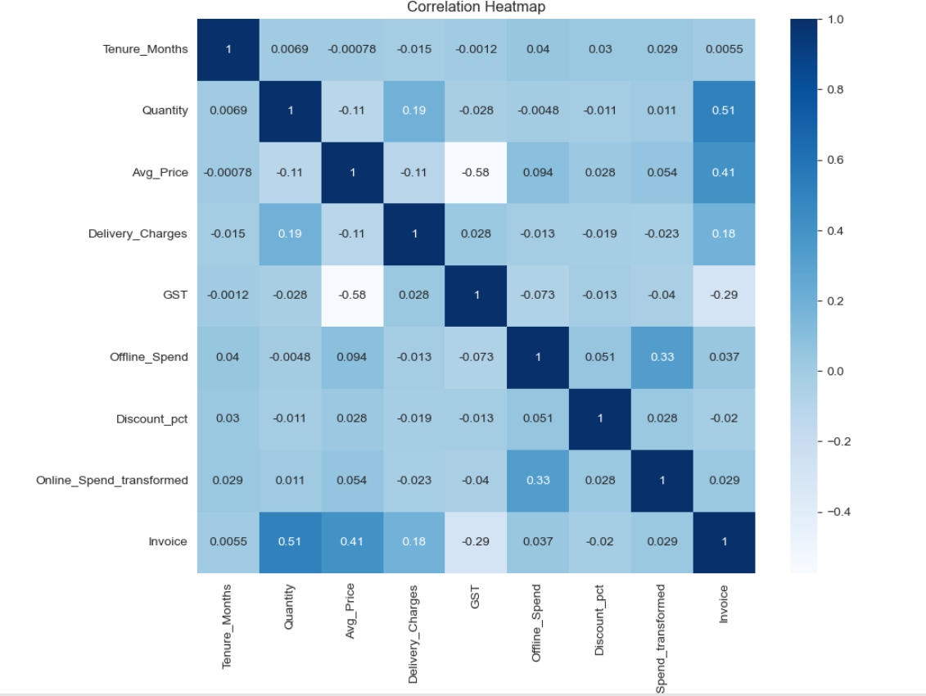
Appendix: Data Visualization

Slide 21
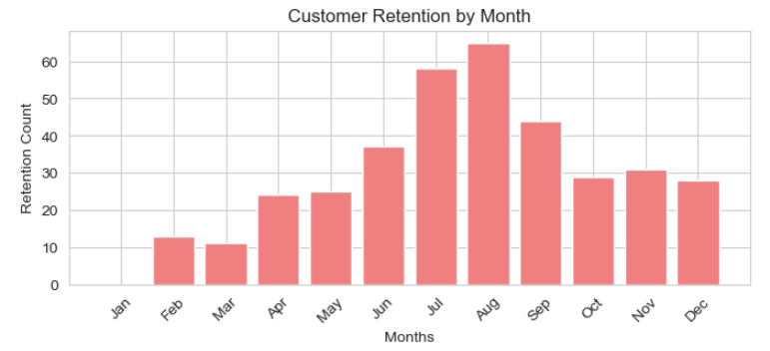
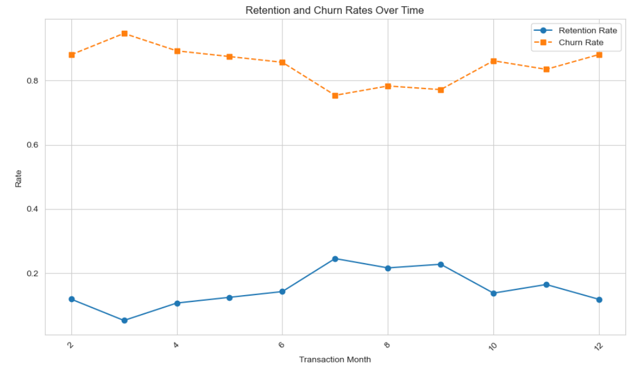
Appendix: Data Visualization

Slide 22
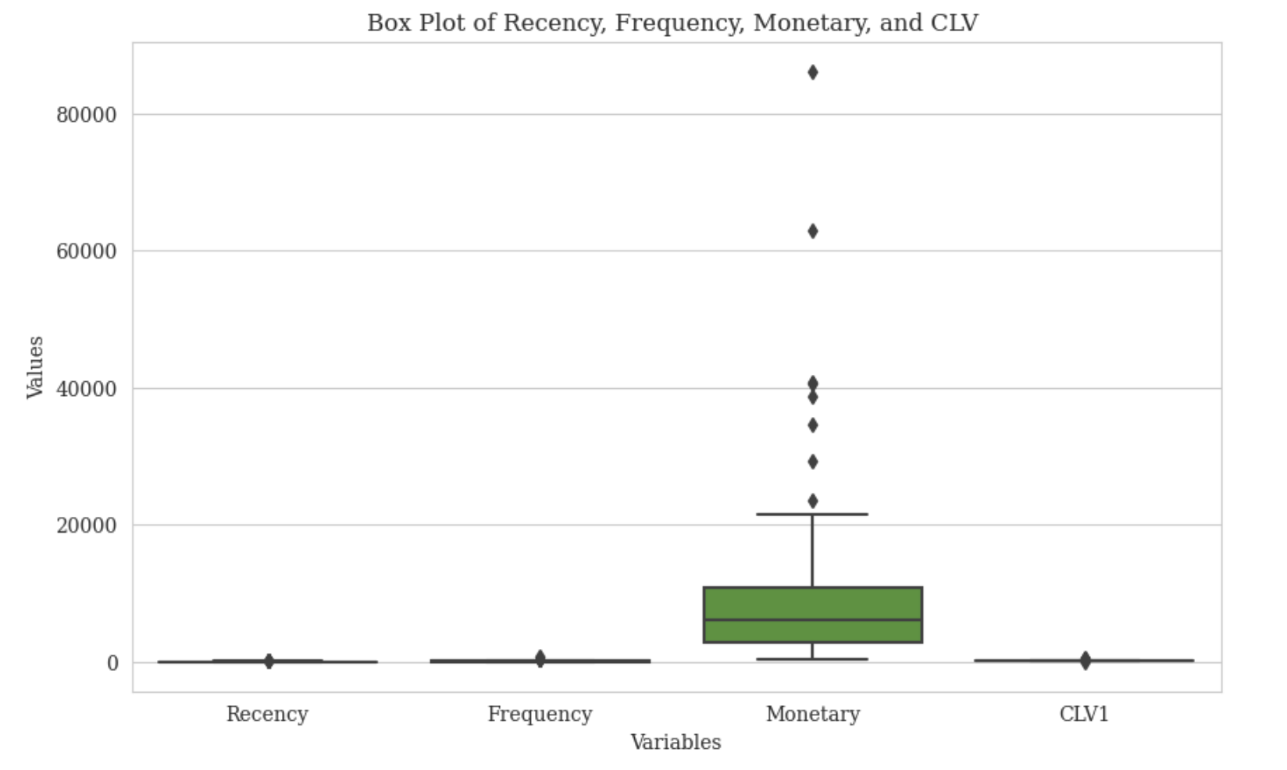
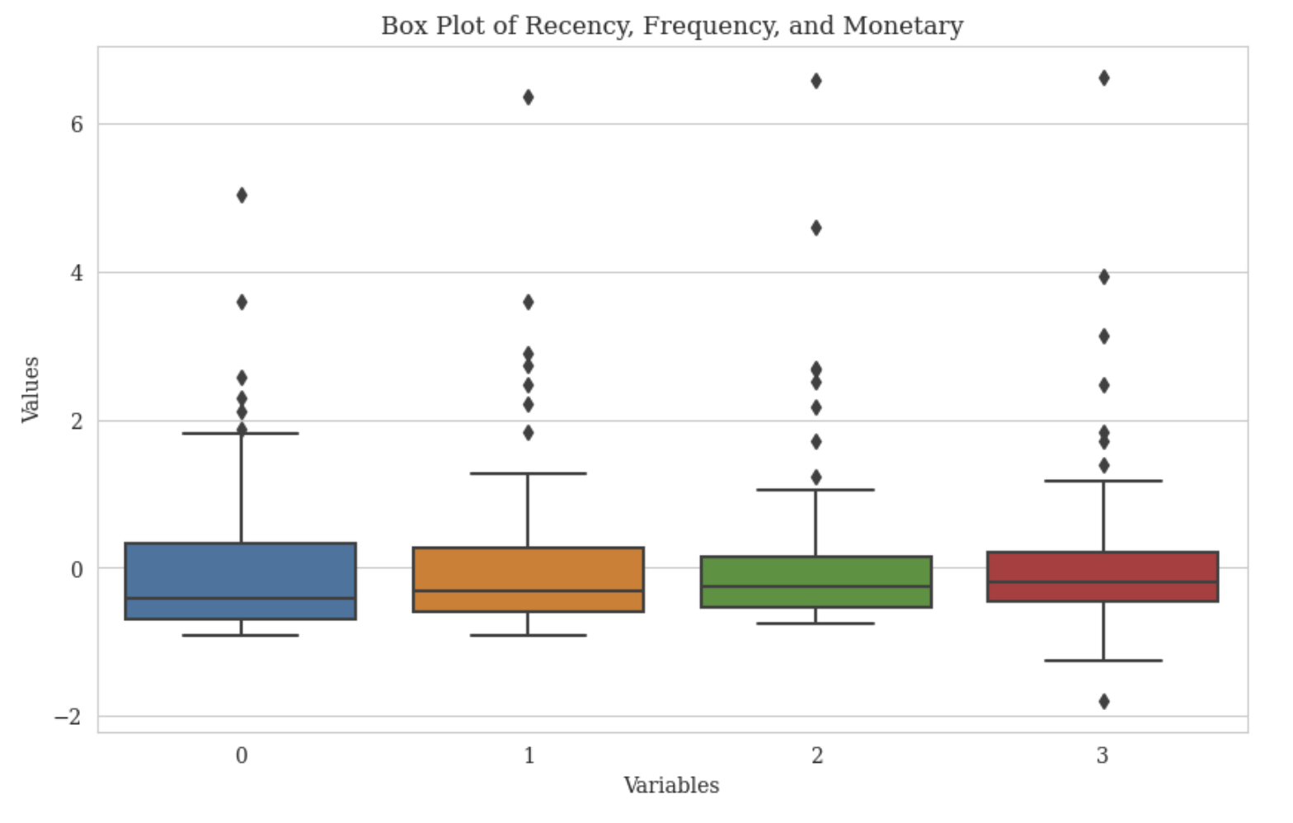
Appendix: Data Visualization
Variable standardization for K-Means - Before and After

Slide 23
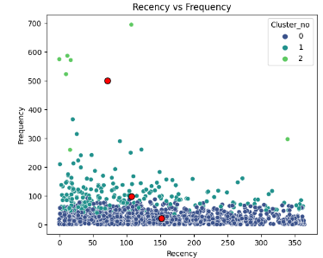
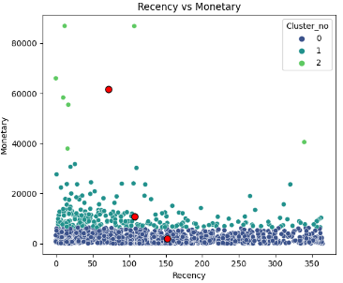
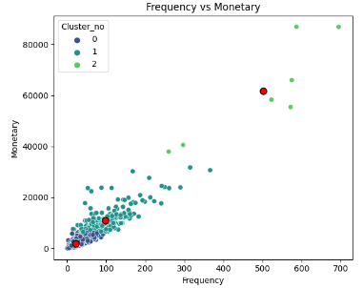
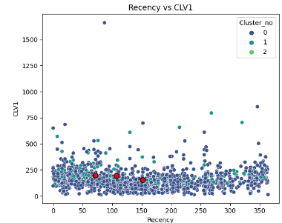
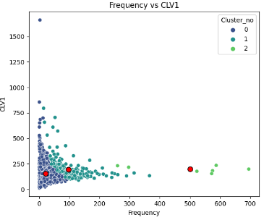
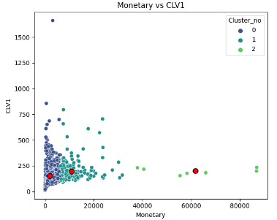
Appendix: Data Visualization

Slide 24
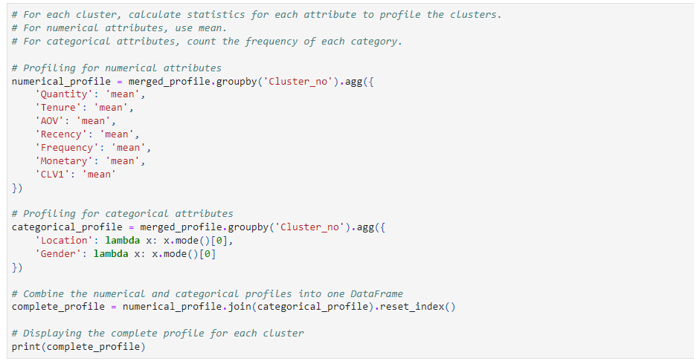
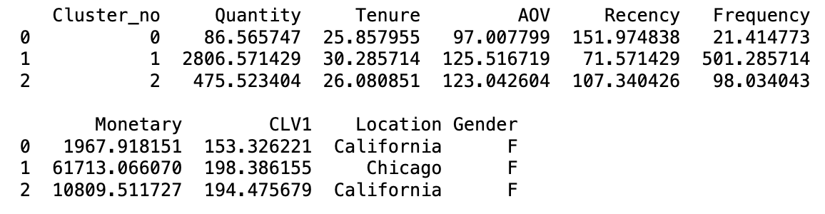
Appendix: Profiling Result

Slide 25
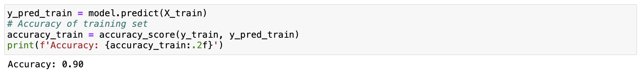
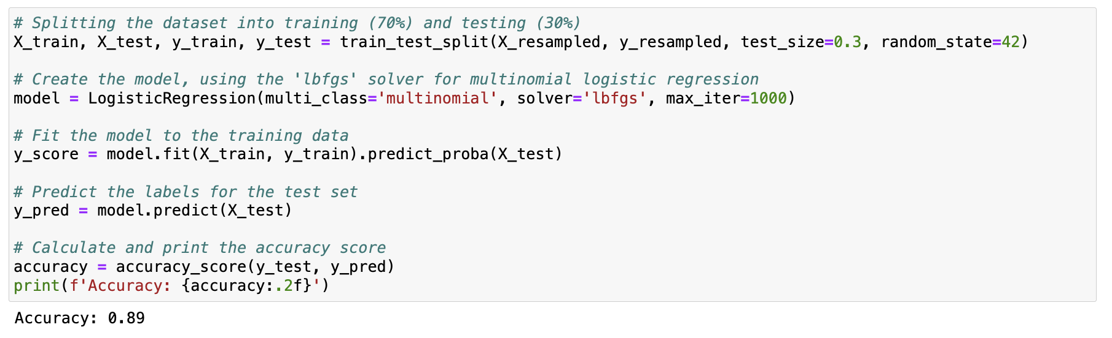
Appendix: Multinomial Logistic Regression

Slide 26
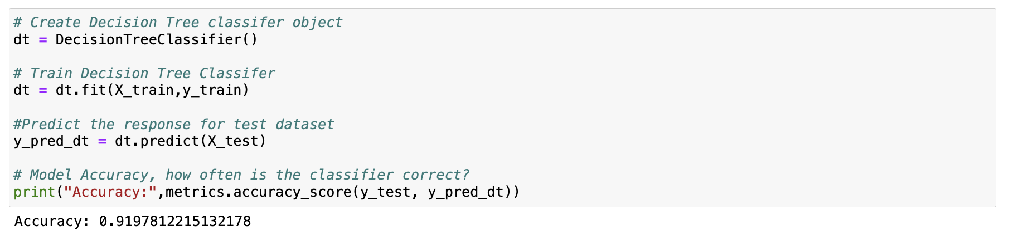
Appendix: Classification Tree

Slide 27
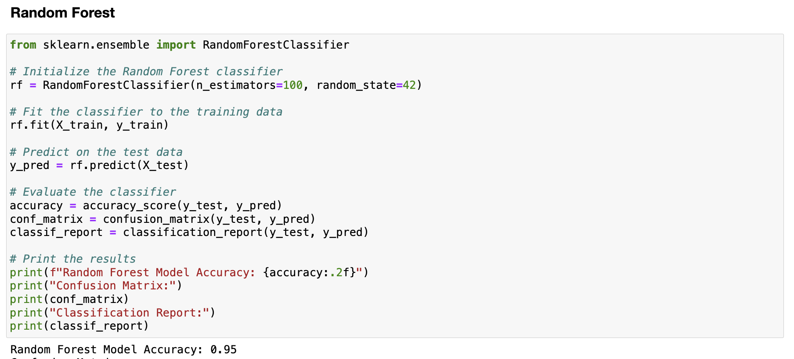
Appendix: Random Forest

Slide 28
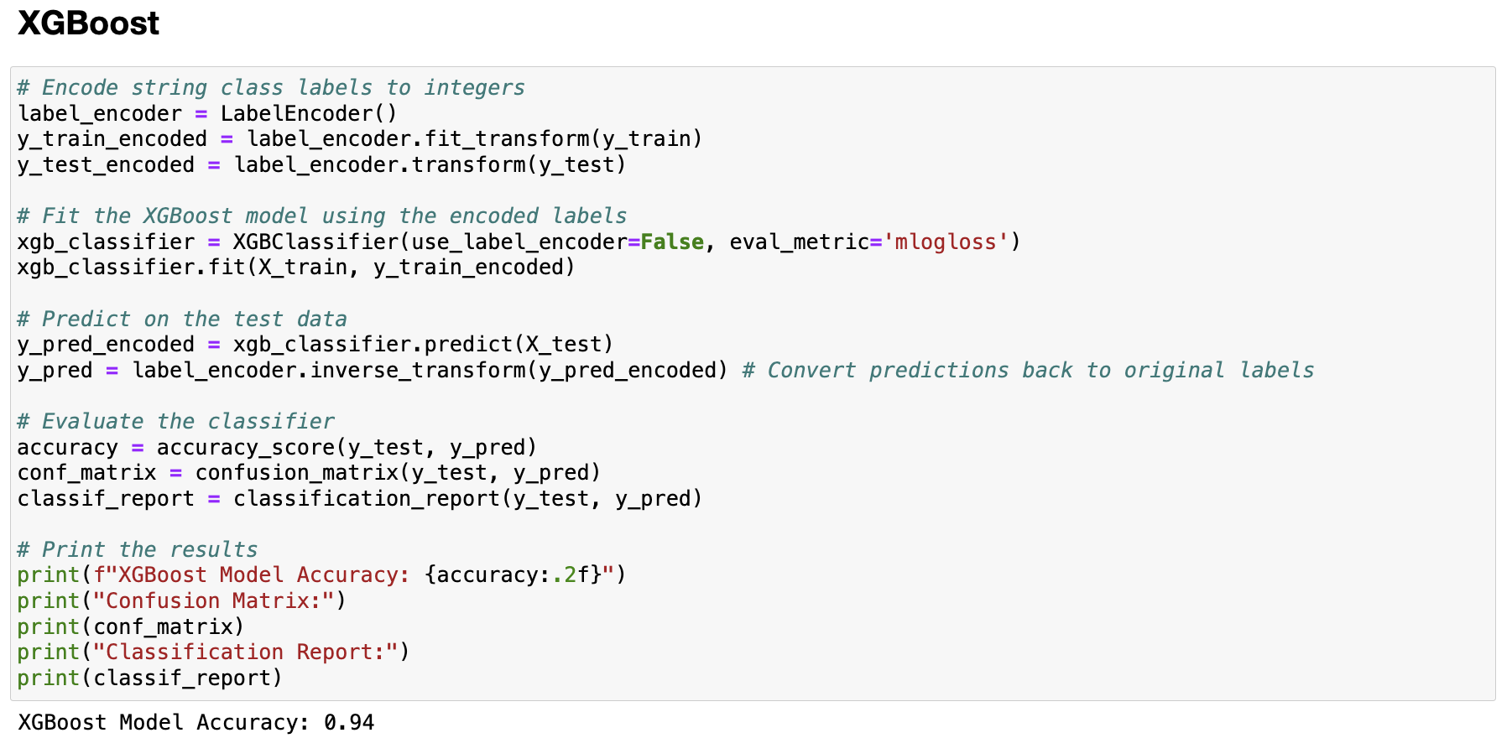
Appendix: XGBoost

Slide 29
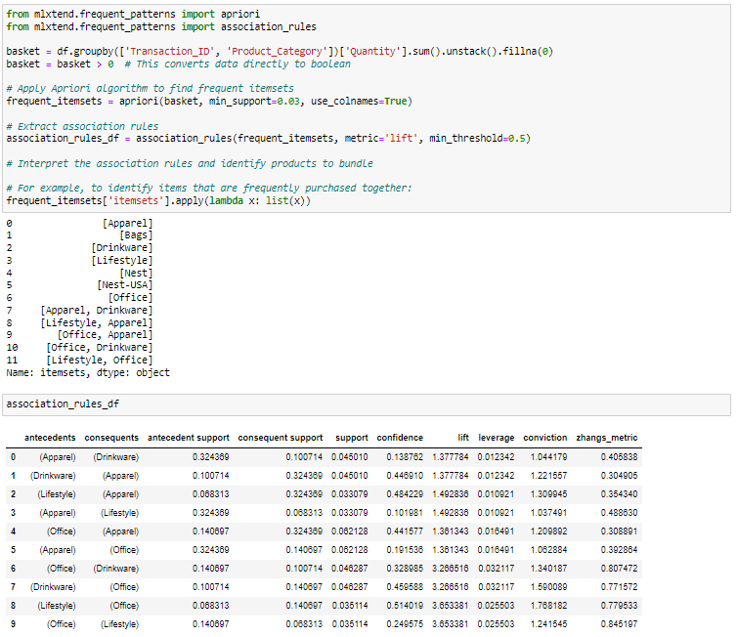
Appendix: Association Rule

